Slide 1



GenZero Strategy
IN COLLABORATION WITH
CONSULT CLAN
Chenna Keshav Chinthakindi
Rashi Vinay Raut
Sai Sinduri Vangala
Yeshwanth Chalapathi Sureshkumar

Slide 2

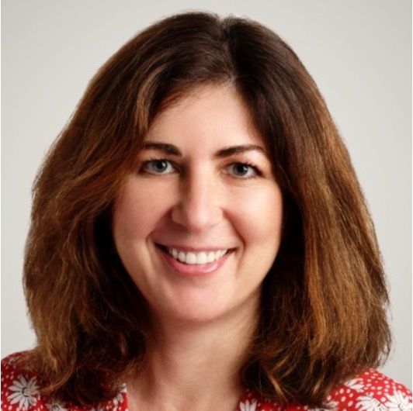






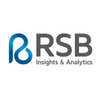
ABOUT THE ENTREPRENEUR
Driven by her passion for storytelling, which forms the core of her professional motivation
Graduate of Northwestern University
2001
Global Director, Marketing & Innovation
2012-2017
Vice President, Product Innovation
2017-2021
Vice President, Client Services
2021-2022
Global Director, Insights & Strategy
2023

Slide 3

GENZERO STRATERGY
In a mission to help businesses make data-driven decisions, unlock valuable insights and use the power of AI and storytelling to position the brands for long term growth.
Founded 2022, Rochester
Marketing strategy, business development, qualitative and quantitative methodologies, predictive analytics, innovation and brand/portfolio management.

Slide 4



DELIVERABLES
Women Owned Business Certification Overview for GenZero Strategy
Service/Bundle Packages
Recommendation for integrating an Online Tracking Tools
Market Research
Social Media Marketing Recommendations
Recommendation of Website with personalized components
Recommendation of a CRM
Business Development

Slide 5


Benefits of getting certified
Access to Opportunities
Networking and Support
Competitive Advantage
Financial Incentives
Community Engagement

Slide 6

SERVICE BUNDLE/PACKAGES
Creating service packages can be an effective way for a consulting firm to market its offerings by bundling together related services that address common client needs or goals. This approach not only simplifies the buying process for clients but also allows the firm to demonstrate comprehensive solutions to complex challenges.
Startup Launch Packages
Digital Transformation Package
Operational Efficiency Package
Growth and Expansion Package
Sustainability and Compliance Package
Leadership and Talent Development Package

Slide 7

WHY DO WE NEED AN ONLINE TRACKING TOOL?
Remote access
Real-time monitoring
Automation
Better Organization
User Friendly Interface Customization and Scalability Smooth Data flow and Tracking

Slide 8

MARKET RESEARCH
OGS Capital
Focused Clients: Online Business, Ecommerce, Energy and Resources,Telecom Industries.
Services: Strategic advice, High quality market research, Fundraising, Full customization
Pricing: Packages like Business plan for Investors, Bank Business plan, Franchise Business plan, Landlord Business plan and Immigration Business plan.
Website: www.ogscapital.com

Slide 9

NIMBL
Focused Clients: Financial expertise and guidance to businesses throughout their entire lifecycle. Notable clients include Neptune, Rapidspa, MVP, Gray Falkon, and Crisp.
Services: Specialized primarily in accounting and tax-related solutions such as budgeting, bill tracking and payments, inventory management, tax return filing, and the development of custom reporting and analytics solutions.
Publishes insightful blogs covering various aspects of financial wealth management
Pricing: Flexible pricing model based on company size, service required and level of engagement.
Website: https://trustnimbl.com/

Slide 10

Bonadio Business Solutions
Focused Clients: Real Estate, Financial Services, Healthcare, Human Services, Manufacturing and Distribution, Public Sector, and Non-profit Organizations.
Services: advisory consulting, assurance and audit, tax consultancy, small business advisory
Pricing: Flexible pricing like hourly rates, project-based fees, and retainer packages
Website: https://www.bonadio.com

Slide 11

Cross Country Consulting
Focused Clients: financial services, life sciences, technology, media and telecommunications, real estate and hospitality, and government contracting
Services: Technical accounting, financial reporting, operational accounting, and process optimization. Technology-Enabled Transformation Services including finance transformation, procurement, and cost transformation.
Pricing: Flexible based on client requirements.
Website: https://www.crosscountry-consulting.com

Slide 12
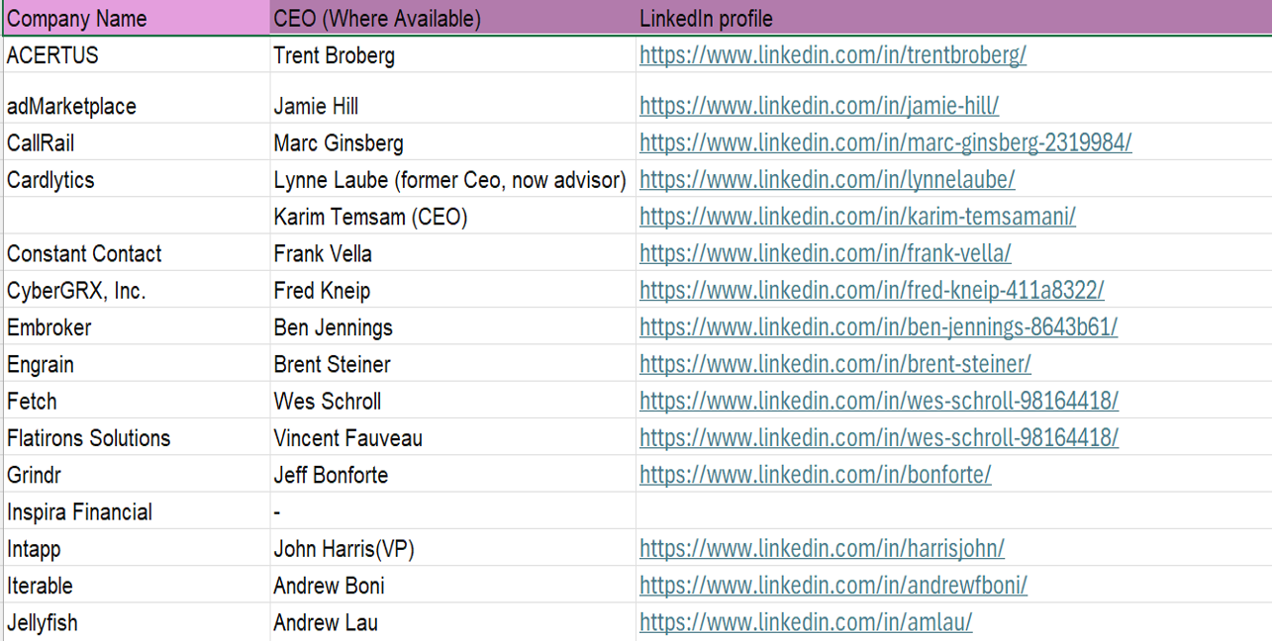
PROSPECTIVE CLIENTS

Slide 13
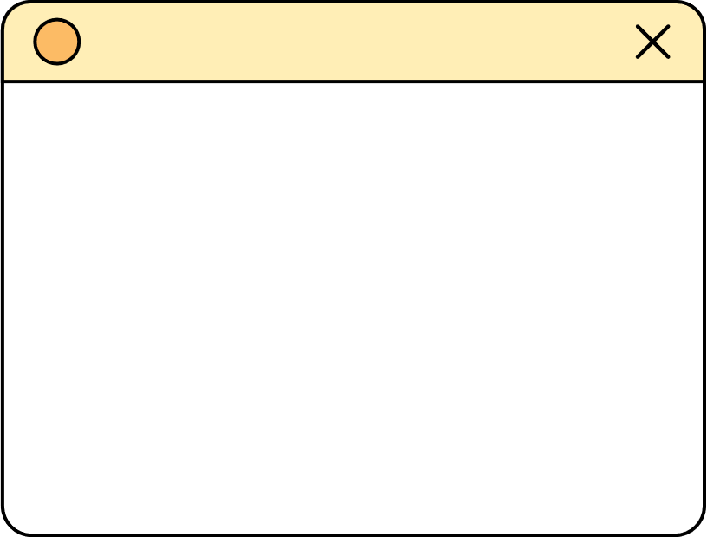





DIGITAL PRESENCE: ELEVATE THE BRAND WITH A WEBSITE
Essential Components on the website
About us
Testimonials
Portfolio
Social Proof
Lead Generation
Blog/Articles
www.genzerostrategy.com

Slide 14
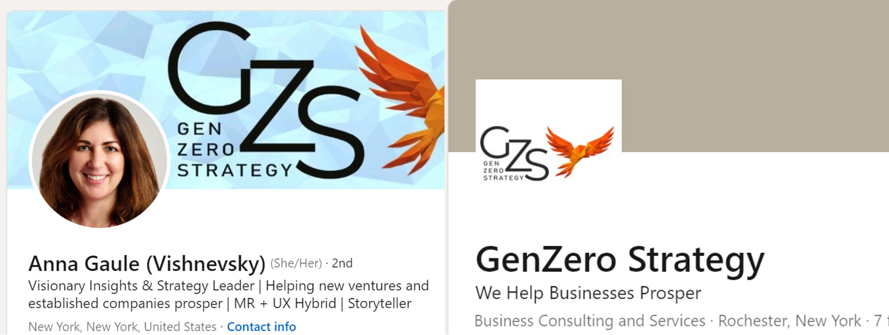
SOCIAL MEDIA MARKETING RECOMMENDATIONS

Slide 15






SOCIAL MEDIA MARKETING RECOMMENDATIONS
SEO Optimization
Client Testimonial
Email Marketing
Paid Advertising
Referral Programs

Slide 16
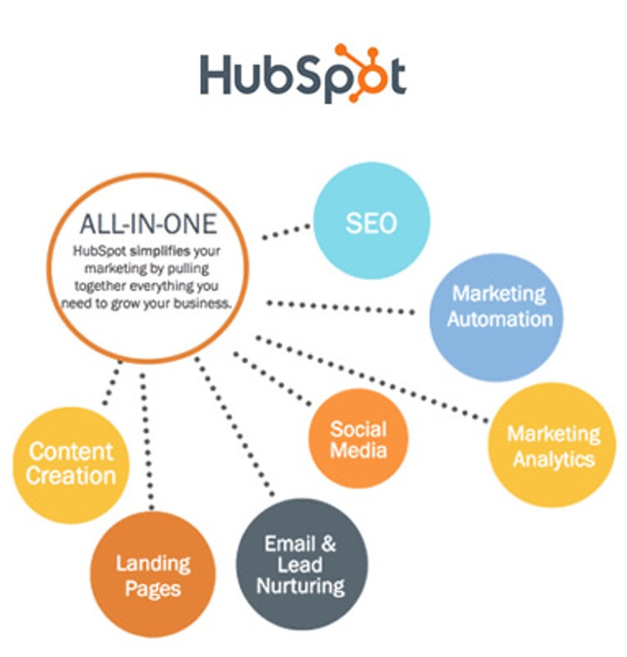



WHY HUBSPOT?
Cost
Automation
Ease of Use

Slide 17




BUSINESS DEVELOPMENT
CONSUMER INSIGHT-DRIVEN PRODUCT INNOVATION
LAUNCH OF A DIGITAL CROWDSOURCING PLATFORM
COMMITMENT TO CONTINUOUS LEARNING AND INDUSTRY ADAPTATION
DIVERSIFICATION STRATEGY

